Slide 1

Information Retrieval
Debbie Taylor

Slide 2
Contents
Introduction
TF*IDF
Cosine Similarity
NLTK WordNetLemmatizer
Testing
Comparisons
Conclusions

Slide 3
Introduction
What is Information Retrieval?
Information retrieval (IR) is finding material (usually documents) of an unstructured nature (usually text) that satisfies an information need from within large collections (usually stored on computers).
[Mogotsi, 2010] Mogotsi, I. C. (2010).

Slide 4
TF*IDF
Term Frequency-Inverse Document Frequency
TF*IDF weights a word for both term frequency (TF) and inverse document frequency (IDF).
The product of that calculation creates the term weighting score.

Slide 5
TF*IDF Calculation
“contact” appears 2 times, in 100 of 1000 documents:
TF:(2 / 100) = 0.02.
IDF:log(1000 / 100) = 10.
TF*IDF term weighting: 0.02 * 10 = 0.2
[Liu, 2015] Liu, E. (2015).

Slide 6
Cosine Similarity (CS)
TF*IDF creates Vectors.
CS uses Vectors to identify similar documents
Uses Dot-Product of 2 Vectors
Find cosine of the Angle
Check Angle to find how similar documents are

Slide 7
NLTK WordNetLemmatizer
Open source Natural Language Toolkit
Stemming
Lemmatizing
[Bird, 2006] Bird, S. (2006)

Slide 8
NLTK - Stemming
Each word broken down into base format
(contacting, contacts, etc changed to contact)
Word can then be identified across all documents

Slide 9
NLTK - Lemmatizing
Specify “Stopwords”
Most common words in English language eg a, as
Remove them from search so weighting and priority not corrupted

Slide 10
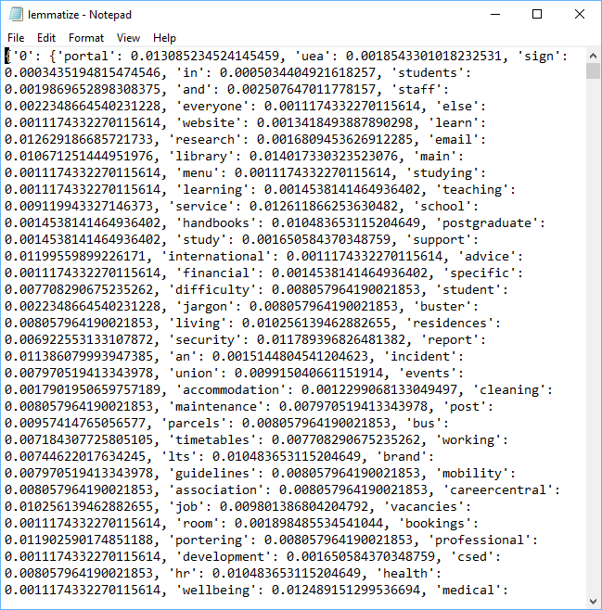
Example: TF*IDF and NLTK output

Slide 11
Testing
“Stopwords Tested” : a, I, is, etc
All correctly return zero results
Chose 3 Questions for advanced testing:
Q1: What is a postgraduate degree?
Q2: Where is there a coffee shop on Campus?
Q3: Where can I get exam support?

Slide 12
Differential Weighting
Question | All processes | No NLTK | No TF*IDF
Q1 | 0.14036 | 0.12958 | 0.00000
Q2 | 0.10299 | 0.01371 | 0.00000
Q3 | 0.19809 | 0.02163 | 0.00000

Slide 13
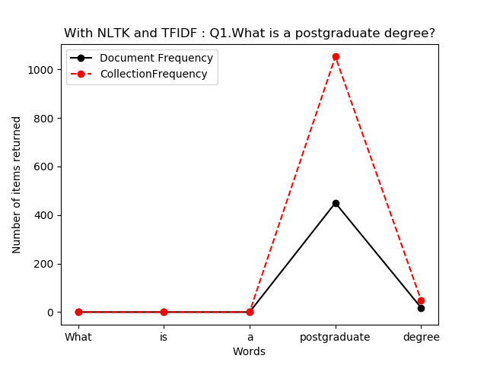
Q1: Document and Term Frequencies With ALL processes

Slide 14
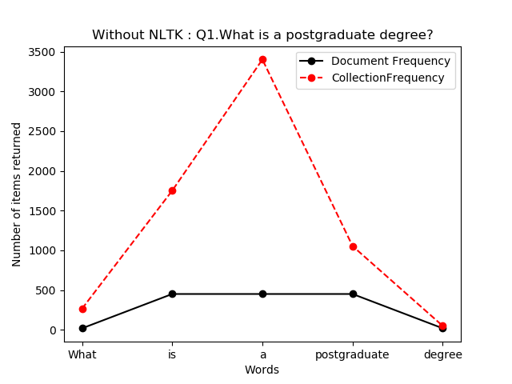
Q1: Document and Term Frequencies Without NLTK

Slide 15
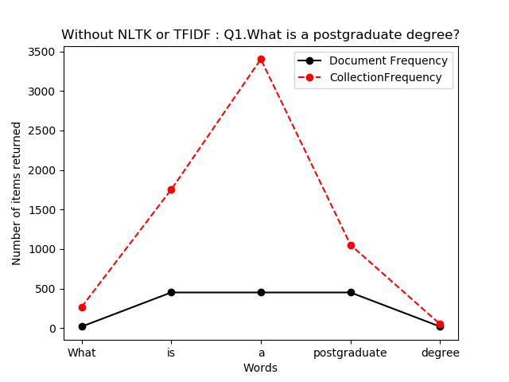
Q1: Document and Term Frequencies Without NLTK and TF*IDF

Slide 16
URL output
Without NLTK:
Without NLTK and TF*IDF:
student-support-service/travel-and-expeditions
postgraduate-research/pgr-regulations-and-forms
graduation/honorary-graduate-nominations
portal.uea.ac.uk/
student-support-service/disability
estates/security

Slide 17
Comparisons
Dan set 10 questions for comparison.
Two covered here are:
Q1: pension query contact
Q7: Erasmus+

Slide 18
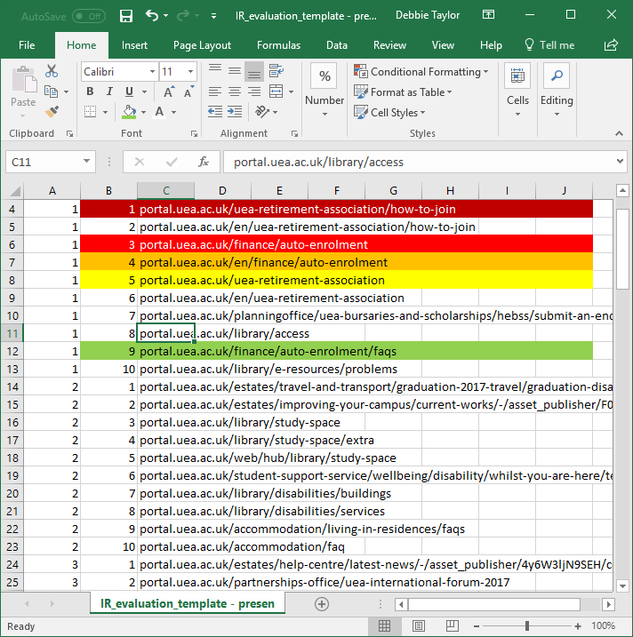
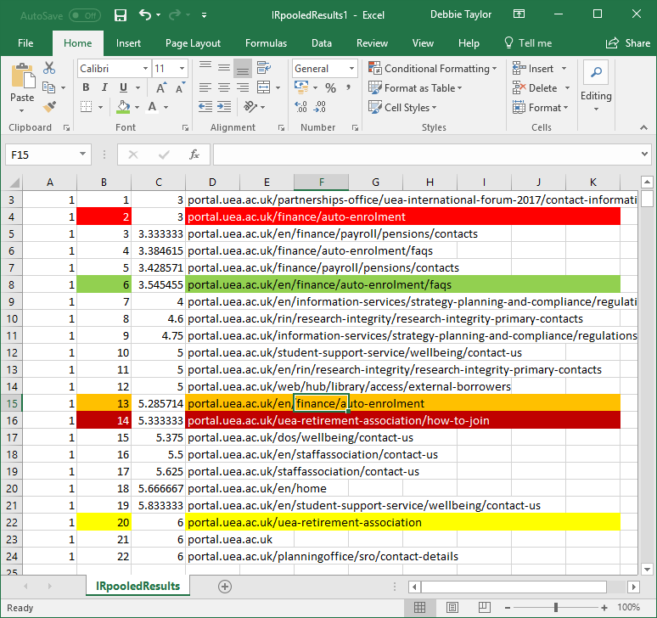
Comparisons for Pension Query Contact
Deb:
Dan:

Slide 19
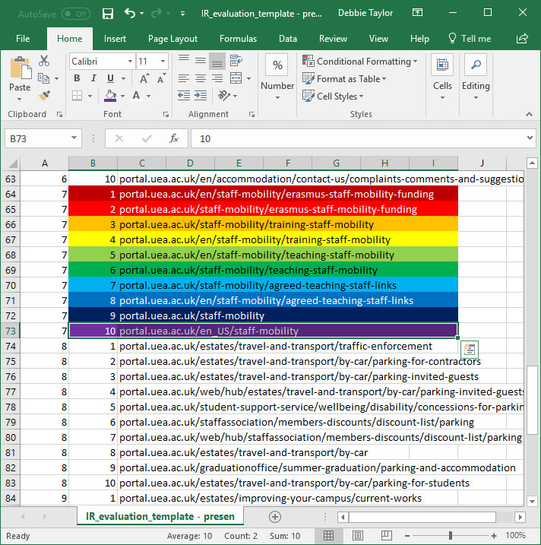
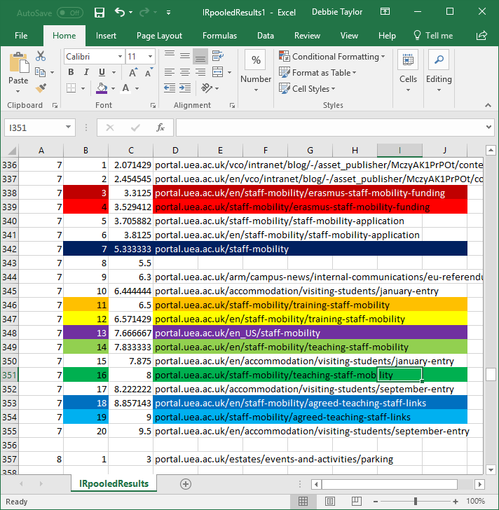
Comparisons for Erasmus+
Deb:
Dan:

Slide 20
Conclusions
Each process has it’s own role to play. Removing even one creates an inefficient system.
REGEX needed more refining, as some data lost at start, which impacted the overall system efficiency
IR is a lot more complex than originally thought.

Slide 21
References
[Baeza-Yates et al., 1999] Baeza-Yates, R., Ribeiro-Neto, B., et al. (1999).
Modern information retrieval, volume 463. ACM press New York.
[Bird, 2006] Bird, S. (2006). Nltk: the natural language toolkit.
In Proceedings of the COLING/ACL on Interactive presentation sessions. Association for Computational Linguistics.
[Liu, 2015] Liu, E. (2015). Tf-idf, term frequency-inverse document frequency.
[Mogotsi, 2010] Mogotsi, I. C. (2010). Christopher d.manning, prabhakar raghavan, and hinrich schutze:
Introduction to information retrieval – Cambridge university press, cambridge, england, 2008, 482 pp, ISBN: 978-0-521-86571-5.

Slide 22

Any Questions?

